Slide 1

Basic concepts of the Inventor API
Presenter
Developer Technical Services

Slide 2
Agenda
API COM model
How do I access the API?
The Object model
Object model tools:
Object browser, VBA debugger
Collection, Enumerator, Inheritance
The Application Object
How to access the Application Object?

Slide 3
COM API Model
Visual Basic
C++
Other...
.Net
C#
VB.Net
Other...
Inventor
Type
Library
Inventor COM Automation API
Inventor

Slide 4
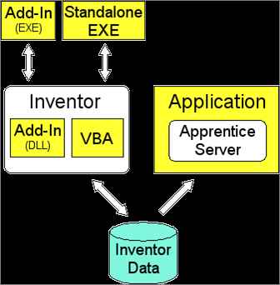
How do I access the API?
VBA
AddIn Dll or Exe
Standalone Exe
Apprentice
Notes:
Explanation of the figure below: The white boxes represent components that provide the API. These are Autodesk Inventor and "Apprentice Server." The blue cylinder at the bottom represents the Autodesk Inventor data you're accessing, i.e. parts, assemblies, etc. All of the yellow boxes represent programs that you write. When one box encloses another box this indicates that the enclosed box is running in the same process as the box enclosing it.
VBA:
When deciding which method to use when programming Autodesk Inventor, there are a few advantages of using VBA to consider. First, VBA is delivered with Autodesk Inventor and does not require you to purchase an additional programming language. Second, you are able to embed programs within Autodesk Inventor documents.
If you have a program that is data-specific, this is a convenient way to keep the program with the data it is designed to use. Third, VBA runs in the same process as Autodesk Inventor so you gain the performance advantages of being in the same process.
AddIn:
Add-Ins are a special type of Autodesk Inventor program. An Add-In is able to do two things that none of the other methods of accessing the API is able to do. First, Autodesk Inventor starts the Add-In automatically whenever Autodesk Inventor is run. Second, an Add-In is able to create commands. Other than these two features, it has the same access and uses the API in the same way as programs written using any of the other API access methods.
You'll notice in the diagram above that Add-In is listed twice: once as a DLL and once as an EXE. With an Add-In, you have the choice of creating a DLL, which will run in the same process as Autodesk Inventor, or an EXE, which will run in a separate process. Almost all Add-Ins will be written as DLLs for increased performance benefits. The ability to have Add-Ins that are EXEs is primarily beneficial for debugging.
Add-Ins can be written using any language that supports the creation of ActiveX EXEs or DLLs, such as Visual C++ and Visual Basic. Add-Ins cannot be created with VBA.
Exe:
A standalone EXE is a program that runs on its own and connects to Autodesk Inventor. This type of program is typically used in the case where you have a program that uses Autodesk Inventor but has its own interface and doesn't require the user to interactively work with Autodesk Inventor. For example, a batch plot utility is typically a standalone EXE. The plot utility can be an EXE that runs independently of Autodesk Inventor and might monitor a database watching for new records to be added.
Standalone EXEs run out-of-process to Autodesk Inventor, so there is some performance penalty, but since they are not usually used for interactive processes it's rarely an issue.
Apprentice:
Apprentice is an ActiveX server that can be used within other applications to provide access to Autodesk Inventor data. Apprentice is essentially a subset of Inventor that runs in process with other applications. Apprentice doesn't have a user interface. The only way to interact with Apprentice is through its API. Apprentice provides access to the assembly structure, B-Rep, geometry, and file properties. Most access to information through Apprentice is read-only; (a couple of exceptions to this are document properties and file references).
Apprentice Server is also available at no cost since it is delivered as part of Design Tracking, which is available on the public Autodesk website.

Slide 5
Where is the SDK?
SDK (Software Development Kits)
Contains C++ header files, samples of C++, VB.NET, C#
Provided with product
Location of the SDK Windows XP: <Inventor install folder>\SDK Windows Vista:
C:\Users\Public\Documents\Autodesk\Inventor <version>\SDK Windows 7:
C:\Users\Public\Documents\Autodesk\Inventor <version>\SDK
API help reference
Before 2013: <Inventor *>\Help_Lite\admapi_*_0.chm
2013: <Inventor *>\Local Help\admapi_*_0.chm
Where * is the version number

Slide 6
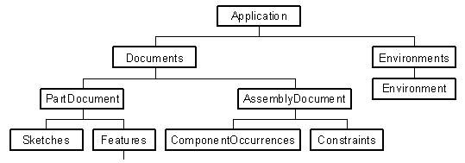
API Objects and the Object Model
In a COM Automation API the functionality is exposed as objects, where each object corresponds to something within the application.
Each object supports various methods, properties, and possibly events.
The objects are accessed through the object model.
The top most object is the Application object.

Slide 7
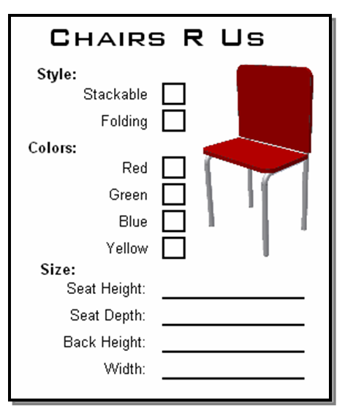
Basics of Object Oriented Programming
API is exposed as a set of objects.
Object oriented terminology:
Object – Represents a logical object. The finished chair in this example.
Property – The various attributes of the chair. The Style, Color, and Size are properties of the chair.
Method – An action performed on the chair; move, fold, throw away.
Event – Notification when something happens to the chair.
Class – The template of an object. The order form for a chair.

Slide 8
Inventor Object Model Example
Inventor’s objects are accessed through the Object Model.
Public Sub GetExtrudeFeature()
Dim oPartDoc As PartDocument
oPartDoc = ThisApplication.ActiveDocument
Dim oExtrude As ExtrudeFeature
oExtrude = oPartDoc.ComponentDefinition.Features.ExtrudeFeatures("Extrusion1")
MsgBox("Extrusion " & oExtrude.Name & " is suppressed: " & oExtrude.Suppressed)
End Sub

Slide 9
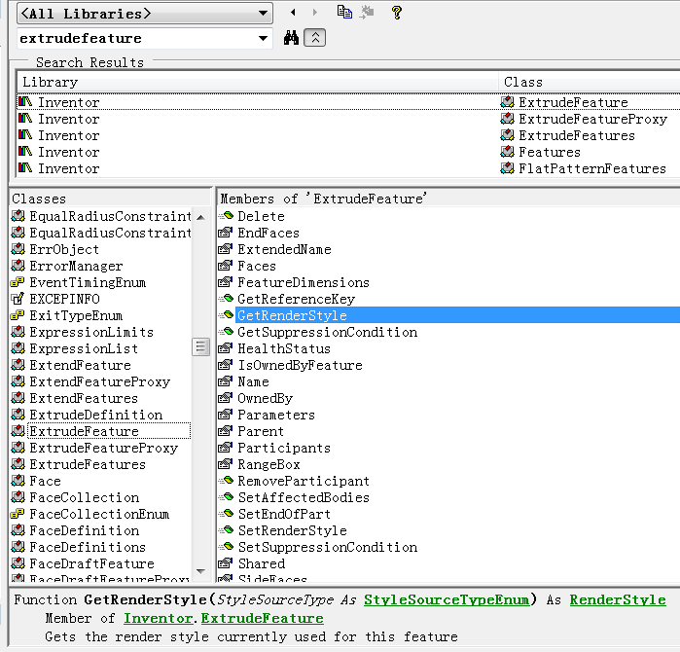
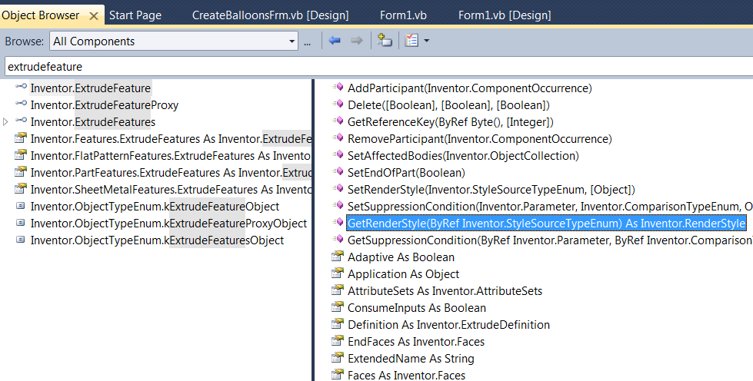
Object Model Tools –Object Browser
Provides user-interface to the contents of the type library
Accessed in VBA using F2, the Object Browser command in the View menu, or pressing the toolbar button.
Accessed in .NET using Ctrl + W,J, or the Object Browser command in the View menu.

Slide 10
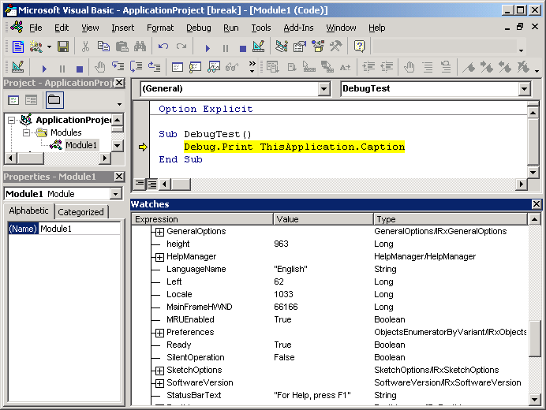
Object Model Tools - VBA Debugger
Provides a “live” view of the object model.
Shows the values of an object properties.
Shows the contents of collections.
VBA debugger provides more information that .Net debugger.

Slide 11
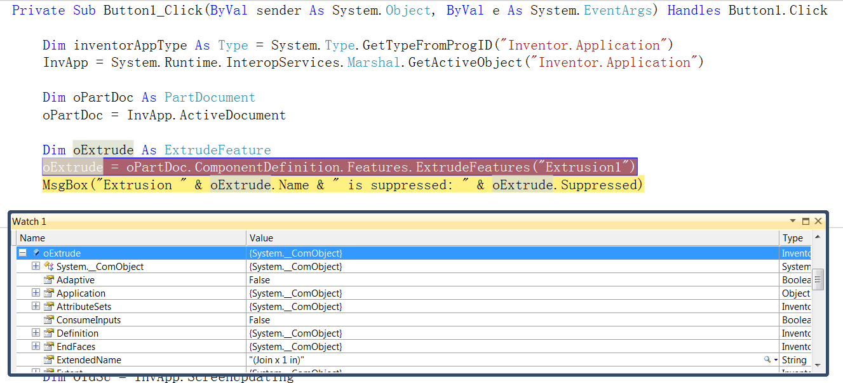
Object Model Tools - .NET Debugger
Provides a “live” view of the object model.
Shows the values of an object properties.
Shows the contents of collections.

Slide 12
Collection Objects
Special object that provides access to a list of objects.
Count property returns number of objects in the collection.
Item property returns a specific object in the collection.
Can specify the index of the object within the collection. The first item is index 1 for all collections within Inventor API.
In some cases you can specify the name of the object within the collection.

Slide 13
Collection vs. Enumerator Objects
Some collections support the functionality to create new objects.
Enumerators are also collections but only support the Count and Item properties.

Slide 14
Iterating Through a Collection
Iterating using Count and Item:
Iterating using For Each statement (more efficient):
Dim oExtrude As ExtrudeFeature
Dim i As Long
For i = 1 To oExtrudeFeatures.Count
Debug.Print(oExtrudeFeatures.Item(i).Name)
Next
Dim oExtrude As ExtrudeFeature
For Each oExtrude In oExtrudeFeatures
Debug.Print(oExtrude.Name)
Next

Slide 15
Derived Objects
Similar to animal taxonomy or classification.
All items under a specific classification share common traits.

Slide 16
Derived Objects – Example
Public Sub SaveDoc()
'Get ActiveDocument, could be Part, Assembly or Drawing
Dim oDoc As Document
oDoc = ThisApplication.ActiveDocument
'Call the Save method on the generic 'Document' object
oDoc.Save()
End Sub

Slide 17
The Application Object
Represents the Inventor Application.
Provides access to the other API objects.
Supports general functionality not specific to a document.
Provides overall event notifications.

Slide 18
Application Window
The Application object provides access to the main window through various methods and properties.
Caption
Left, Top, Width, Height, GetAppFrameExtents, Move
WindowState
Visible
MainFrameHwnd

Slide 19
Utility Objects
SoftwareVersion – Provides information about the version of Inventor.
ChangeManager, CommandManager, FileManager, HelpManager, TransactionManager, MeasureTools, UserInterfaceManager – Provide access to functions related to a particular area.
TransientGeometry – Temporary geometry objects.
TransientObjects – Temporary utility objects
TransientBrep – Temporary Boundary Representation objects
Notes:
'List all commands which Internal Name contains CommName
Public Function FindCommandByInternalName(CommName As String)
'Gets CommandManager's Control Definitions
Dim oControlDefs As ControlDefinitions
Set oControlDefs = ThisApplication.CommandManager.ControlDefinitions
'Iterates trough all Control Definitions and prints InternalName and DescriptionText
'of commands that match a part of the input string
Dim oControlDef As ControlDefinition
For Each oControlDef In oControlDefs
If InStr(oControlDef.InternalName, CommName) <> 0 Then
Debug.Print "[Internal Name]" & oControlDef.InternalName & Space(45 - Len(oControlDef.InternalName)) & " [Description]" & oControlDef.DescriptionText
End If
Next
End Function
Public Function FindCommandBarByInternalName(CommName As String)
Dim oComBars As CommandBars
Set oComBars = ThisApplication.UserInterfaceManager.CommandBars
Dim oBar As CommandBar
For Each oBar In oComBars
If InStr(oBar.InternalName, CommName) <> 0 Then
Debug.Print "[Internal Name] " & oBar.InternalName & Space(45 - Len(oBar.InternalName)) & " [Description]" & oBar.DisplayName
End If
Next
End Function
Public Sub TestFindCommandBar()
Call FindCommandBarByInternalName("Part")
End Sub
Public Sub TestFindCommand()
Call FindCommandByInternalName("Punch")
End Sub

Slide 20
Shortcuts to “Active” Objects
Properties that provide direct access to various “Active” objects.
ActiveColorScheme
ActiveDocument
ActiveView
ActiveEnvironment
ActiveEditObject – Returns the object currently being edited. This can be a document that’s been opened, a document that’s been in-place edited, a sketch, a sheet, and a flat pattern.
ActiveEditDocument – Returns the document currently be edited.

Slide 21
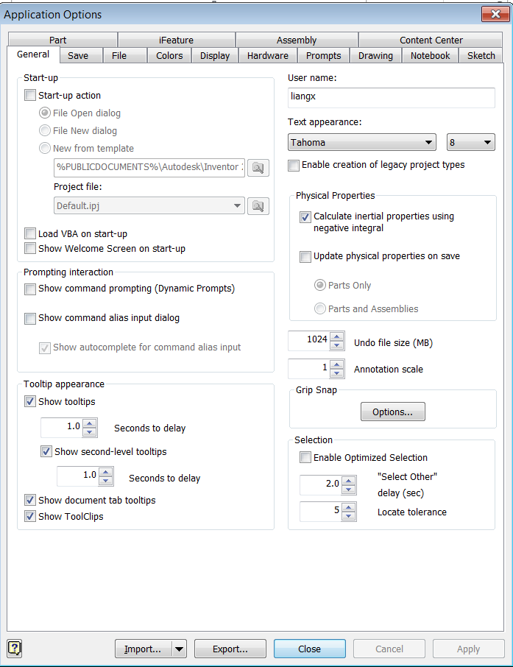
Application Options
Provides access to objects that expose the various application options.
AssemblyOptions
DisplayOptions
FileOptions
GeneralOptions
HardwareOptions
NotebookOptions
PartOptions
SaveOptions
Sketch3DOptions
SketchOptions
iFeatureOptions
ColorSchemes

Slide 22
Application Level Objects
Documents – All currently open documents, including those that are referenced by other documents.
ApplicationAddIns – The available Add-Ins.
VBAProjects – VBA related objects.

Slide 23
Events
Provides access to several different sets of events:
ApplicationEvents
AssemblyEvents
FileAccessEvents
FileUIEvents
ModelingEvents
RepresentationEvents
SketchEvents
StyleEvents

Slide 24
Miscellaneous
SilentOperation – Causes all dialogs to be suppressed and take the default behavior. Useful for batch processing operations where warning dialogs would normally be displayed as files are opened, processed, and closed.
LanguageName, Locale – Language information.
MRUEnabled, MRUDisplay – Controls display of most recently used file list at the bottom of the File menu.
Ready – Indicates if Inventor is fully initialized.
StatusBarText – Text shown in the status bar.

Slide 25
How to access the Application Object? – VB.NET
Access in Inventor’s VBA using the ThisApplication property.
From an AddIn: see Module 10
Access from outside Inventor using either the GetObject or CreateObject methods:
Dim _InvApplication As Inventor.Application = Nothing
Try
Try ' Try to get an active instance of Inventor
_InvApplication =
System.Runtime.InteropServices.Marshal.GetActiveObject("Inventor.Application")
Catch ex As Exception
End Try
If _InvApplication Is Nothing Then ' If not active, create a new Inventor session
Dim inventorAppType As Type = System.Type.GetTypeFromProgID("Inventor.Application")
_InvApplication = System.Activator.CreateInstance(inventorAppType)
'Must be set visible explicitly
_InvApplication.Visible = True
End If
End Try

Slide 26
How to access the Application Object? – C#
Similar to VB.NET, access from outside Inventor using either the GetObject or CreateObject methods:
string progId = "Inventor.Application";
Type inventorApplicationType = Type.GetTypeFromProgID(progId);
Inventor.Application instance;
try
{
instance = (Inventor.Application)Marshal.GetActiveObject(progId);
instance.Visible = true;
return instance;
}
catch (COMException)
{
// No running instance, so proceed with creating a new instance
}
instance = (Inventor.Application)Activator.CreateInstance(inventorApplicationType);
instance.Visible = true;

Slide 27
Lab: Access the Application Object
Create an external Exe that tries to access the Inventor Application object at startup. If a running instance of Inventor is not found, then create a new instance using “CreateInstance”
Create some controls in order to:
- Ask user for Height and Width values and set the ActiveView to the entered values.
- Ask user for the Application caption and set it.

Slide 28

Notes:
Thank you!
Questions?

